Slide 1
Regularization Techniques in Deep Learning

Slide 2
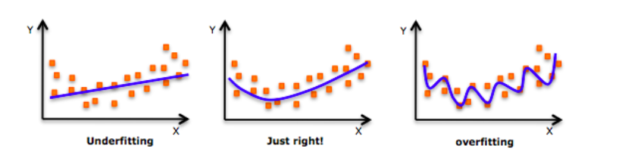
As we move towards the right in this image, our model tries to learn too well the details and the noise from the training data, which ultimately results in poor performance on the unseen data.
In other words, while going towards the right, the complexity of the model increases such that the training error reduces but the testing error doesn’t.

Slide 3
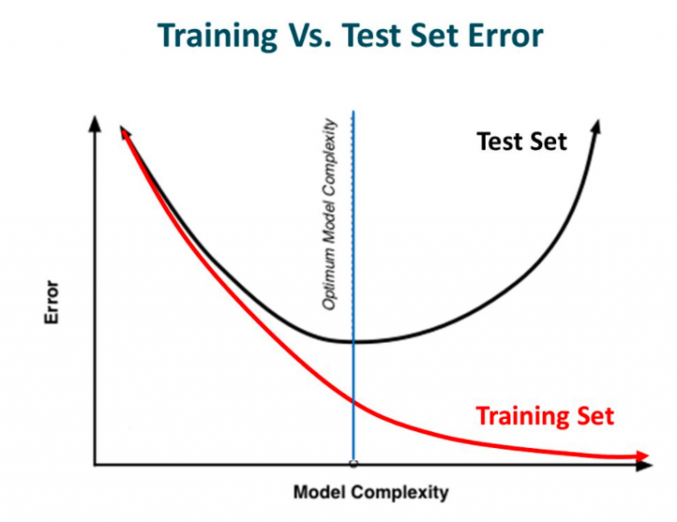
This makes the neural network more prone to overfitting.

Slide 4
Regularization
Regularization is a technique which makes slight modifications to the learning algorithm such that the model generalizes better. This in turn improves the model’s performance on the unseen data as well.
According to Ian Goodfellow, Yoshua Bengio and Aaron Courville in their Deep Learning Book:
“In the context of deep learning, most regularization strategies are based on regularizing estimators. Regularization of an estimator works by trading increased bias for reduced variance. An eﬀective regularizer is one that makes a proﬁtable trade, reducing variance signiﬁcantly while not overly increasing the bias.”

Slide 5
The bias error is an error from wrong assumptions in the learning algorithm. High bias can cause an algorithm to miss the relevant relations between features and target outputs. This is called underfitting.
The variance is an error from sensitivity to small fluctuations in the training set. High variance may result in modeling the random noise in the training data. This is called overfitting.
The bias-variance tradeoff is a term to describe the fact that we can reduce the variance by increasing the bias. Good regularization techniques strive to simultaneously minimize the two sources of error. Hence, achieving better generalization.

Slide 6
How to introduce regularization in deep learning models
Modify the loss function: add regularization terms
The most common family of approaches used before the Deep Learning era in estimators such as linear and logistic regression, are parameters norm penalties.
Here we add a parameter norm penalty Ω(θ) to the loss function J(θ;X,y):
J′(θ;X, y)=J(θ; X, y)+a Ω(θ)
where θ denotes the trainable parameters, X the input, and y the target labels. a is a hyperparameter that weights the contribution of the norm penalty, hence the effect of the regularization.

Slide 7
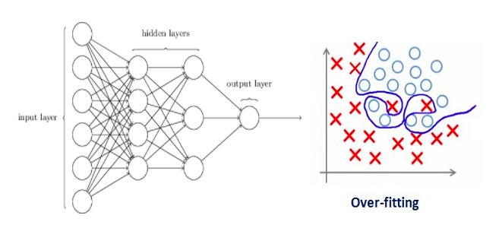
In deep learning, regularization actually penalizes the weight matrices of the nodes.
Let’s consider a neural network which is overfitting on the training data.

Slide 8
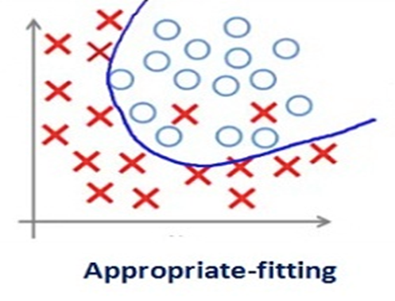
Assume that our regularization coefficient is so high that some of the weight matrices are nearly equal to zero. This will result in a much simpler linear network and slight underfitting of the training data.
Such a large value of the regularization coefficient is not that useful. We need to optimize the value of regularization coefficient in order to obtain a well-fitted model

Slide 9
Different Regularization Techniques in Deep Learning
L2 & L1 regularization
L1 and L2 are the most common types of regularization. These update the general cost function by adding another term known as the regularization term.
Cost function = Loss + Regularization term
Let Loss function is binary cross entropy
Due to the addition of this regularization term, the values of weight matrices decrease because it assumes that a neural network with smaller weight matrices leads to simpler models. Therefore, it will also reduce overfitting to quite an extent.

Slide 10


Regularization term differs in L1 and L2
squared norm
In L2
Here lambda is the regularization parameter. It is the hyperparameter whose value is optimized for better results. L2 regularization is also known as weight decay or ridge regression as it forces the weights to decay towards zero (but not exactly zero).
In L1
In this, we penalize the absolute value of the weights. Unlike L2, the weights may be reduced to zero here. Hence, it is very useful when we are trying to compress our model. Otherwise, we usually prefer L2 over it.

Slide 11
Elastic net
Elastic net is a method that linearly combines L1 and L2 regularization with the goal to acquire the best of both worlds .
the penalty term is as follows:
Ω(θ)=λ1​∣∣w∣∣1​+λ2​∣∣w∣∣2²
Elastic Net regularization reduces the effect of certain features, as L1 does, but at the same time, it does not eliminate them. So it combines feature elimination from L1 and feature coefficient reduction from the L2.

Slide 12
Entropy Regularization
Entropy regularization is another norm penalty method that applies to probabilistic models. It has also been used in different Reinforcement Learning techniques.
Ω(X)=−∑p(x)log(p(x))
it forces the probability distribution towards the uniform distribution to reduce variance.

Slide 13
Label smoothing
Noise injection is one of the most powerful regularization strategies. By adding randomness, we can reduce the variance of the models and lower the generalization error
It is a way of adding noise at the output targets, aka labels. Let’s assume that we have a classification problem. In most of them, we use a form of cross-entropy loss and softmax to output the final probabilities.

Slide 14
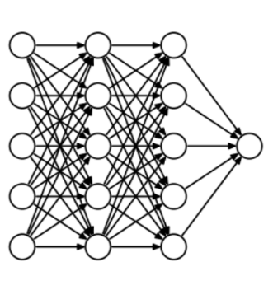
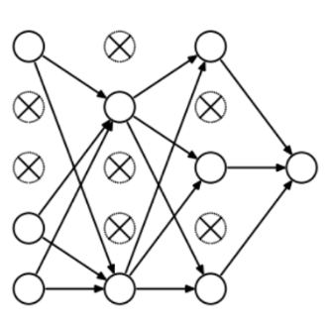
Dropout
This is one of the most interesting types of regularization techniques. It also produces very good results and is consequently the most frequently used regularization technique in the field of deep learning.
At every iteration, dropout randomly selects some nodes and removes them along with all of their incoming and outgoing connections

Slide 15
So each iteration has a different set of nodes and this results in a different set of outputs. It can also be thought of as an ensemble technique in machine learning.
Ensemble models usually perform better than a single model as they capture more randomness. Similarly, dropout also performs better than a normal neural network model.
This probability of choosing how many nodes should be dropped is the hyperparameter of the dropout function.
Dropout can be applied to both the hidden layers as well as the input layers.

Slide 16
Other Dropout variations
Inverted dropout also randomly drops some units with a probability p. The difference with traditional dropout is: During training, it also scales the activations by the inverse of the keep probability 1−p. The reason behind this is: to prevent the activations from becoming too large thus the need to modify the network during the testing phase. The end result will be similar to the traditional dropout.
Gaussian dropout: instead of dropping units during training, is injecting noise to the weights of each unit. The noise is, more often than not ,Gaussian. This results in:
  A reduction in the computational effort during testing time.
  No weight scaling is required.
  Faster training overall

Slide 17
DropConnect follows a slightly different approach. Instead of zeroing out random activations (units), it zeros random weights during each forward pass. The weights are dropped with a probability of 1−p. This essentially transforms a fully connected layer to a sparsely connected layer. It can be seen as a generalization of Dropout to the full-connection structure of a layer.
Variational Dropout: we use the same dropout mask on each timestep. This means that we will drop the same network units each time. This was initially introduced for Recurrent Neural Networks and it follows the same principles as variational inference.
Attention Dropout: popular over the past years because of the rapid advancements of attention-based models like Transformers. As you may have guessed, we randomly dropped certain attention units with a probability p.

Slide 18
Adaptive Dropout: a technique that extends dropout by allowing the dropout probability to be different for different units. The intuition is that there may be hidden units that can individually make confident predictions for the presence or absence of an important feature or combination of features.
Embedding Dropout: a strategy that performs dropout on the embedding matrix and is used for a full forward and backward pass.
DropBlock: is used in Convolutional Neural networks and it discards all units in a continuous region of the feature map.

Slide 19
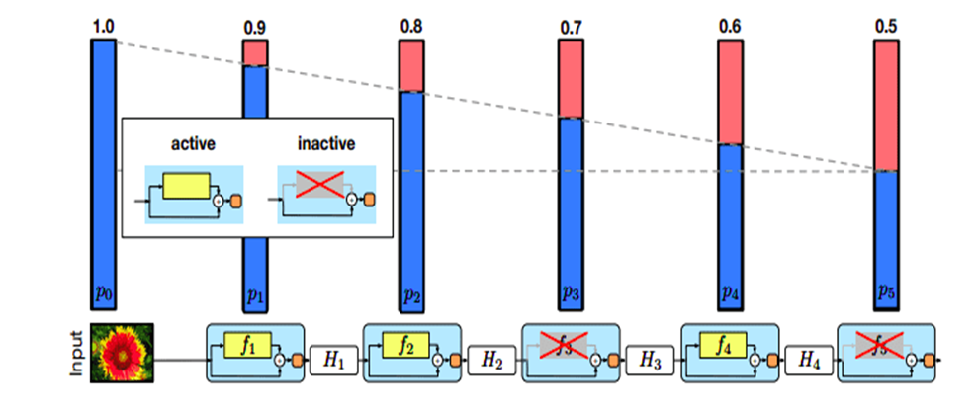
Stochastic Depth
Stochastic depth goes a step further. It drops entire network blocks while keeping the model intact during testing. The most popular application is in large ResNets where we bypass certain blocks through their skip connections.

Slide 20
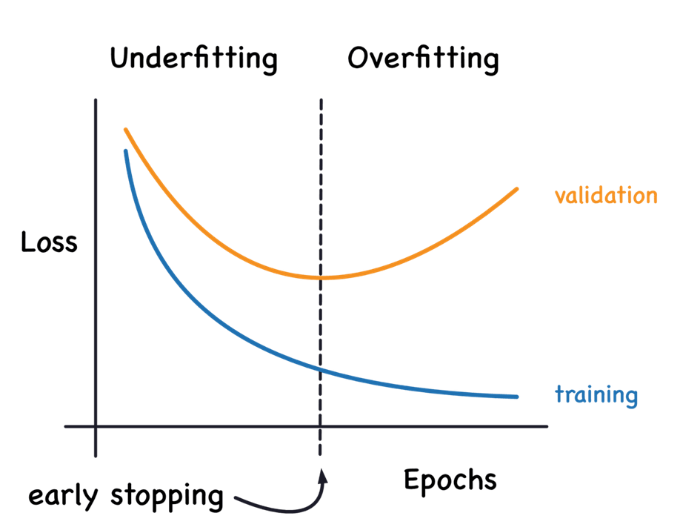
Early stopping
Early stopping is one of the most commonly used strategies because it is very simple and quite effective. It refers to the process of stopping the training when the training error is no longer decreasing but the validation error is starting to rise.

Slide 21
This implies that we store the trainable parameters periodically and track the validation error. After the training stopped, we return the trainable parameters to the exact point where the validation error started to rise, instead of the last ones.
It is a very efficient hyperparameter selection algorithm, which sets the number of epochs to the absolute best. It essentially restricts the optimization procedure to a small volume of the trainable parameters space close to the initial parameters.
It can also be proven that in the case of a simple linear model with a quadratic error function and simple gradient descent, early stopping is equivalent to L2 regularization.

Slide 22
Parameter sharing
Parameter sharing follows a different approach. Instead of penalizing model parameters, it forces a group of parameters to be equal.
Batch normalization
Batch normalization (BN) can also be used as a form of regularization. Batch normalization fixes the means and variances of the input by bringing the feature in the same range.

Slide 23
Data augmentation
Data augmentation refers to the process of generating new training examples to our dataset. More training data means lower model’s variance, a.k.a lower generalization error. It can also be seen as a form of noise injection in the training dataset.
Data augmentation can be achieved in many different ways.
Basic Data Manipulations: The first simple thing to do is to perform geometric transformations on data. Most notably, if we’re talking about images we have solutions such as: Image flipping, cropping, rotations, translations, image color modification, image mixing etc. Cutout is a commonly used idea where we remove certain image regions. Another idea, called Mixup, is the process of blending two images from the dataset into one image.
Feature Space Augmentation : Instead of transforming data in the input space as above, we can apply transformations on the feature space. For example, an autoencoder might be used to extract the latent representation. Noise can then be added in the latent representation which results in a transformation of the original data point.

Slide 24
GAN-based Augmentation:
Generative Adversarial Networks have been proven to work extremely well on data generation so they are a natural choice for data augmentation.
Meta-Learning:
In meta-learning, we use neural networks to optimize other neural networks by tuning their hyperparameters, improving their layout, and more.
A similar approach can also be applied in data augmentation. In simple terms, we use a classification network to tune an augmentation network into generating better images.
Example: We feed random images to an Augmentation Network (most likely a GAN), which will generate augmented images. Both the augmented image and the original are passed into a second network, which compares them and tells us how good the augmented image is. After repeating the process the augmentation network becomes better and better at producing new images.

